Slide 1
Academics and Academic Expectations at UC Merced
Elizabeth J. Whitt
Vice Provost and Dean for Undergraduate Education

Slide 2
Overview
Welcome!
What can your student expect in classes?
What is general education all about?
What does your student need to do to succeed?

Slide 3
How would you describe your student as a student?
What does your student expect of her/his academic experiences at UCM?
What do you expect?

Slide 4
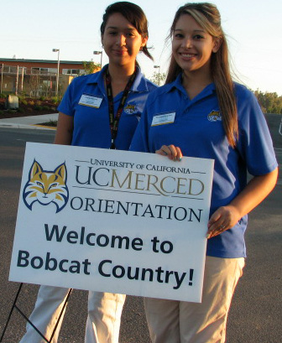
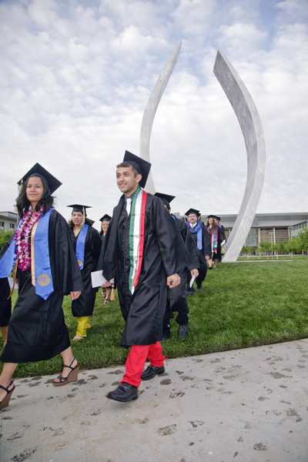
What does your student need to do to succeed at UCM?
How do we get from here…
…to here?

Slide 5
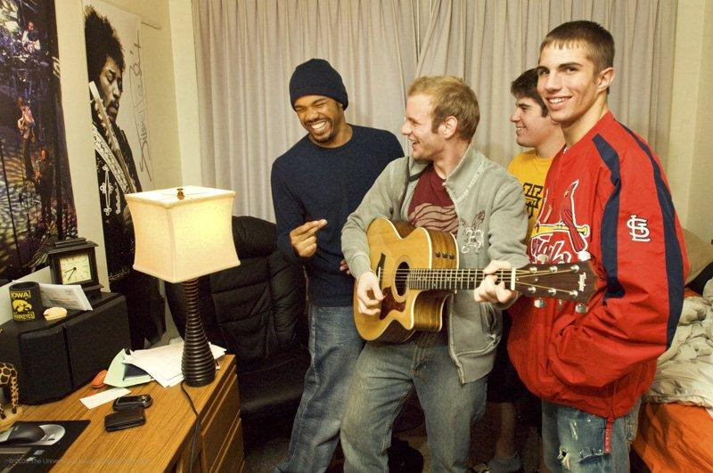
Student Success
What students do -- time and energy focused on academics and other educational experiences.
What the university does – using effective tools to help students be successful.
And families are partners for student success for both.

Slide 6
What Students Do: Time Key: Time in college is different than time in high school.

Slide 7
What Students Do: Time <Less structured, less scheduled >More freedom, more distractions

Slide 8
What Students Do: Time <Less structured, less scheduled >More freedom, more distractions

Slide 9
“I’m taking only 15 Units, so I’m in class just 15 hours a week”
Classes are described as having a certain number of “units” (for example, 3 or 4).
Your student will take at least 12 units each semester, but more typically 15 or 16.
That means he or she will be in class about 15 hours a week.
But units do not represent the number of hours your student will spend on classes each week; it will be much more work than that.

Slide 10
How do course units translate into expected effort at UC Merced?
In general: Students should expect to spend at least* 3 hours of effort outside of class for every course unit.
*Depends on the student and the class.

Slide 11
Time on Task
For a 15-unit course load, a student should expect to spend at least 45 hours a week on
homework (writing assignments, lab write-ups, math problems),
preparing for class (studying reading assignments, preparing for labs and discussions),
studying notes after class, and
preparing for tests; writing papers.

Slide 12
How do course units translate into expected effort at UC Merced?
Courses can have quite different mixtures of lecture, homework, study, labs, and other activities.
Regardless of the mix, they add up to a lot of work.
Which often takes students by surprise:
“People told me college would be harder than high school, but it’s really harder than high school.”

Slide 13
Example: Psy 10—Analysis of Psychological Data (4 Units)
Lectures: 3½ hours per week.
Homework assignments: 2 hours or more per week.
Reading and studying: 6½ hours or more per week.
Total: this 4 unit class will require at least 12 hours of time each week.

Slide 14
Example: Bio 1—Contemporary Biology (4 units)
Lecture: 3 hours per week.
Discussion: 1 hour per week.
Laboratory: 2 hours per week.
Reading and studying: 6 or more hours per week.
Total: this 4 unit class will require at least 12 hours of time each week.

Slide 15
What Students Do: Effort Key: Academic effort in college is different than academic effort in high school.

Slide 16
What Students Do: Effort >Longer timelines <Fewer deadlines <Fewer grades >Greater independence >Greater student control and responsibility

Slide 17
What are lectures like?
They tend to be large.
Material is fast-paced, complex.
They require careful preparation by students and by faculty.
They require students to focus, perhaps even more than in smaller classes.

Slide 18
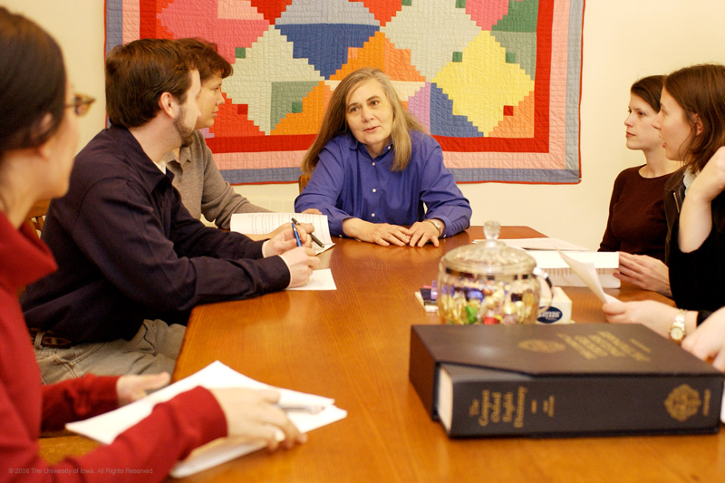
What about discussions?
Some classes are smaller and allow a more interactive style of instruction.
Large, lecture-style classes often have smaller discussion sections too.
Again, preparation and focus are key. But so is participation.

Slide 19
And labs?
Labs involve small groups of students working to gain first-hand experience of what they are studying.
Preparation is required.

Slide 20
Why Spend Time on General Education?
My son or daughter is going to be a (medical doctor, engineer, linguist, insert your special interest here). Why does he need to study things outside that discipline?
For one thing: Part of the University’s job is to create well educated, informed, well-rounded citizens.
For another: Many of the skills employers want are developed first in the general education curriculum: effective written and oral communication, integrative thinking, critical thinking, teamwork . . .

Slide 21
National Survey of Employers (AAC&U 2013)
93%: “a candidate’s demonstrated capacity to think critically, communicate clearly, and solve complex problems is more important than their undergraduate major.”
90+%: those they hire must demonstrate ethical judgment and integrity; intercultural skills; and the capacity for continued new learning.
75+%: colleges should place more emphasis on: critical thinking, complex problem-solving, written and oral communication.

Slide 22
General Education at UCM
University Requirements – all UCM Students
Writing
Math
CORE 001
School and Major Requirements
Subjects outside the major, intending to provide breadth to a student’s program: History, English, Psychology, Biology, Math, Sociology, Political Science, and on and on.

Slide 23
Keys to Student Success -- What UCM Students Say:
Fall 2013 FY students in academic difficulty (at least 1 D or F) at midterm:
73% I don’t allow enough time out of class to meet requirements of my courses
62% I haven’t used available tutoring
60% I haven’t met with my instructors to get help
55% In my approach to my classes, I have good intentions but I don’t follow through

Slide 24
Keys to student success at UCM: Typical end-of-semester comments
I should have started sooner
I should have studied harder
I should have gone to class more often
I should have done more practice problems
I should have gone to the instructor’s office hours
I should have asked for help
I should have taken my academics more seriously

Slide 25
Keys to Student Success at UC Merced*
Manage time effectively.
Develop and use good study skills and habits. From DAY ONE.
Work hard (and smart).
Use all available resources.
Don’t cheat.
*So you can be helpful when the time comes

Slide 26
Time Management
Go to class! And use time between classes to do homework and study.
Keep a calendar with all due dates and assignments (course syllabus) and other commitments.
Don’t procrastinate; allow enough time to prepare and review.
Allow time for other activities. Yes, your students should study and go to class, but they should also eat, do laundry, work out, see a movie, spend time with friends, get involved in the community. And sleep.

Slide 27
Good Study Skills – make them a habit
Reading and studying are not the same thing.
Know what you need to do to be successful.
Be prepared: for class, for labs, for exams.
Don’t fall behind.
Start papers early.
Know how you are doing
in the class:
Mid-semester grades
Office hours

Slide 28
Mid-semester Grades:
October 21, 2014

Slide 29
Know Course Expectations
Every class has a syllabus -- the roadmap of the class.
A clear list of expectations (students and faculty member) and outcomes.
Specific deadlines, due dates, and evaluation criteria.
So read the syllabus. A lot.
Obtain all course materials specified by the instructor; this includes textbooks. Yes, they can be expensive, but required readings really are required.
For the sake of your student’s success, she or he should avoid counting on sharing readings with classmates or friends.

Slide 30
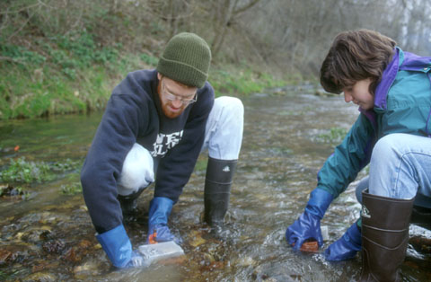
Work Hard – and Smart
College shouldn’t be easy. It should be rewarding and fun and meaningful, but not easy.
Putting in time isn’t the same as working smart. Or hard.
Challenges can be overcome; new learning is part of the experience!
Being a full-time student is a full-time job, deserving of effort, pride, personal investment, and personal responsibility.
Academics.
Other forms of involvement:
research, clubs, organizations,
community service.
Part-time employment.

Slide 31
Don’t Cheat
Honesty and integrity are essential values of any academic community.
Academic dishonesty:
Plagiarism
Cheating
Unauthorized collaboration
There are serious consequences for academic dishonesty.

Slide 32
What The University Does: Support and Challenge Key: We expect your student to be successful and we provide lots of resources to help him or her succeed.

Slide 33
Keys to Student Success -- What UCM Students Say:
Fall 2013 FY students in academic difficulty (at least 1 D or F) at midterm:
73% I don’t allow enough time out of class to meet requirements of my courses
62% I haven’t used available tutoring
60% I haven’t met with my instructors to get help
55% In my approach to my classes, I have good intentions but I don’t follow through

Slide 34
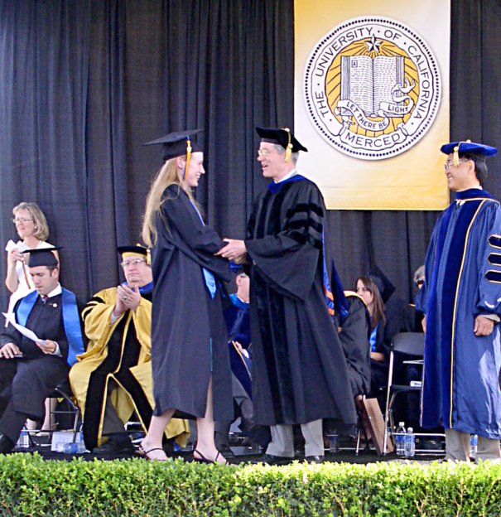
Use all available resources – We are here to help your student be successful.
Tutoring: courses, writing
Faculty Office Hours
Academic Advisors
Peer Advisors
Health and Wellness Services
Workshops: writing, study skills, time management
Residence Life Staff
Career Services/Professional Advancement
STEM Resource Center

Slide 35
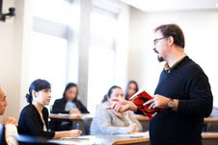
Faculty are Resources, Too
The faculty at UC Merced have been successful students! They can help your student with the process of learning how to learn.
Their advice on how to set goals, manage time, and enjoy learning is a valuable resource.
Where does a student access that resource?
Office hours!

Slide 36
What Can Families Do? Support and Challenge You play a significant role in your student’s success. Support: encouragement, independence, information Challenge: encouragement, independence, information

